Slide 1
Garments
Management System
1405072
1405075
1405079
1405086
1405087
Student ID:

Slide 2
Use Case diagram for the Sub-Systems
Storing Information
Order Management
Work Distribution

Slide 3
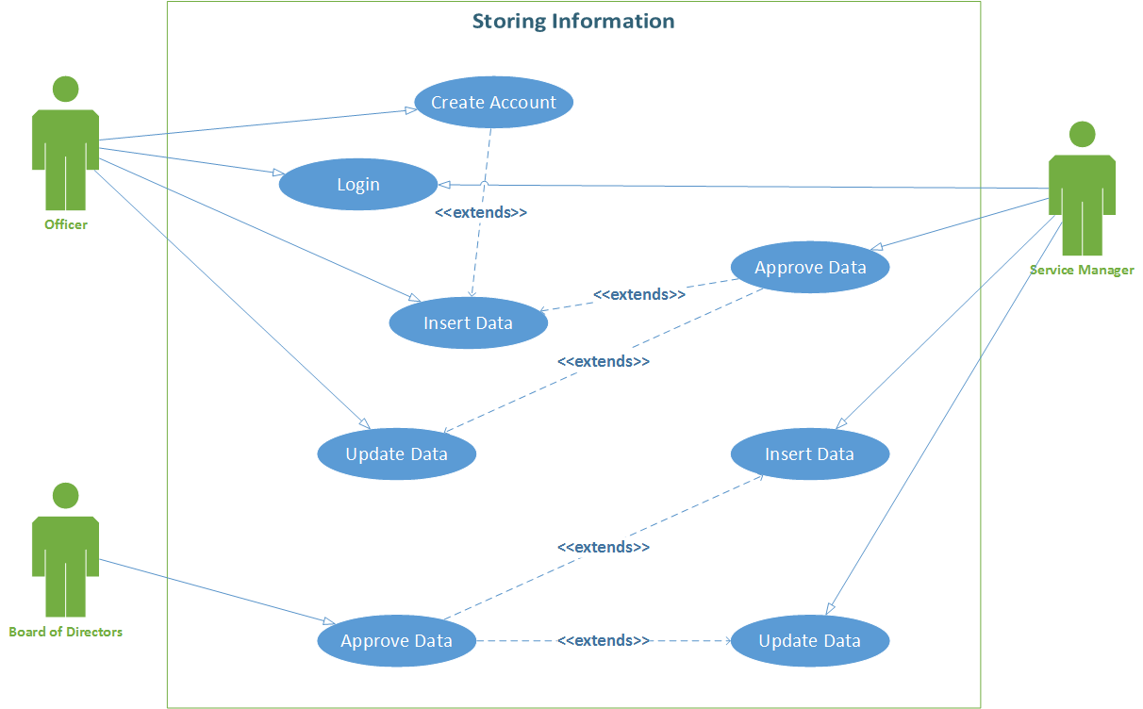

Slide 4
Use Case Narrative for Insert Data
in Storing Information Subsystem
Use Case Name | Insert Data
Use Case ID | UC_SI_001
Priority | High
Primary Actor | Officer
Secondary Actor | Service Manager, Board of Directors
Description | This use case describes the procedure by which an officer, more specifically technology officer enters data in our system. Here an officer will take manually collected data and input them in the information system. Some pre-created data form will be used.

Slide 5
Use Case Narrative for Insert Data
in Storing Information Subsystem (Continued)
Pre-condition | Officer has to log in and must have manually collected data.
Trigger | This use case will be triggered when an officer enters the system to input data.
Typical Course of events | Actor Action | System Response
 | Officer inserts data. | System takes the data and sends it to service manager for approval.
 | Service Manager approves data. | System stores data.

Slide 6
Use Case Narrative for Insert Data
in Storing Information Subsystem (Continued)
Alternate Course of events | Actor Action | System Response
 | Officer provides invalid information. | System notifies and asks to submit the data again.
 | Service Manager does not approve the inserted data. | System rejects the entry and notifies Officer.
Business rule | Officer can not insert invalid data type.
Post Conditions | <<Not applicable>>
Conclusion | This use case concludes when an officer has successfully inserted the required data.

Slide 7
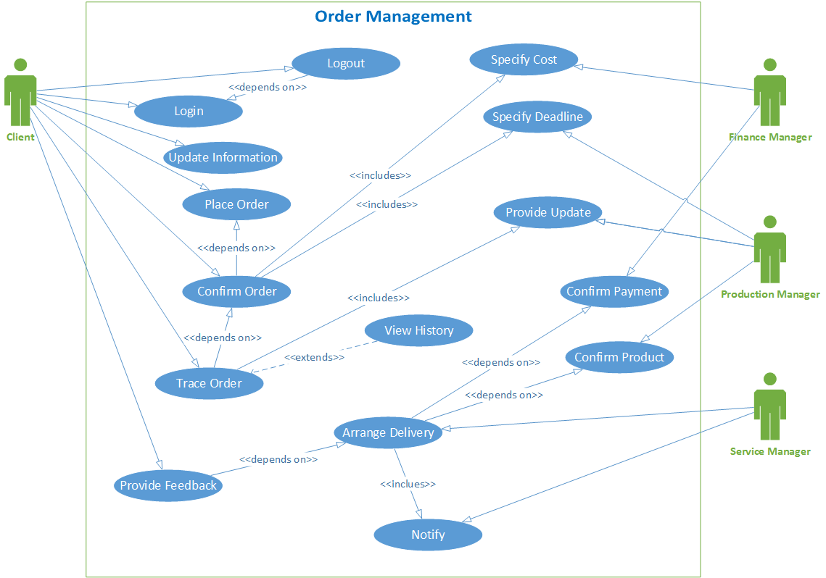

Slide 8
Use Case Narrative for Order Confirmation
in Order Management Subsystem
Use Case Name | Order Confirmation
Use Case ID | UC_OM_001
Priority | High
Primary Actor | Client
Secondary Actor | Production Manager, Finance Manager
Description | In this use-case, an order will be confirmed by a client depending on estimated cost and deadline provided by the finance and production manager. At first, the client will place an order. After that, the finance and production manager will estimate a cost and deadline. Then the client will review the cost and deadline and confirm the order.

Slide 9
Use Case Narrative for Order Confirmation
in Order Management Subsystem (Continued)
Pre-condition | Placement of order with description of product, amount, deadline by Client after signing in.
Trigger | This use case will be triggered when a client who is registered in our system wants to confirm an order.
Typical Course of events | Actor Action | System Response
 | Client specifies product description, amount, deadline. | System stores the provided data and sends them to the corresponding managers for approval.
 | Production Manager checks the deadline and approves. | System gives green signal about deadline.
 | Finance Manager calculates the estimated cost and approves. | System gives green signal about cost.
 | Client gets positive response from system and confirms order. | System informs the managers.

Slide 10
Use Case Narrative for Order Confirmation
in Order Management Subsystem (Continued)
Alternate Course of events | Actor Action | System Response
 | Production or Finance Manager does not approve the order. | System tells client order placement not possible.
 | Client does not confirm order. | System suggests the client to check again.
Business rule | Client can not order products by invalid amount, design etc.
Post Conditions | Production Manager must distribute the work.
Conclusion | This use case concludes when the order is confirmed.

Slide 11
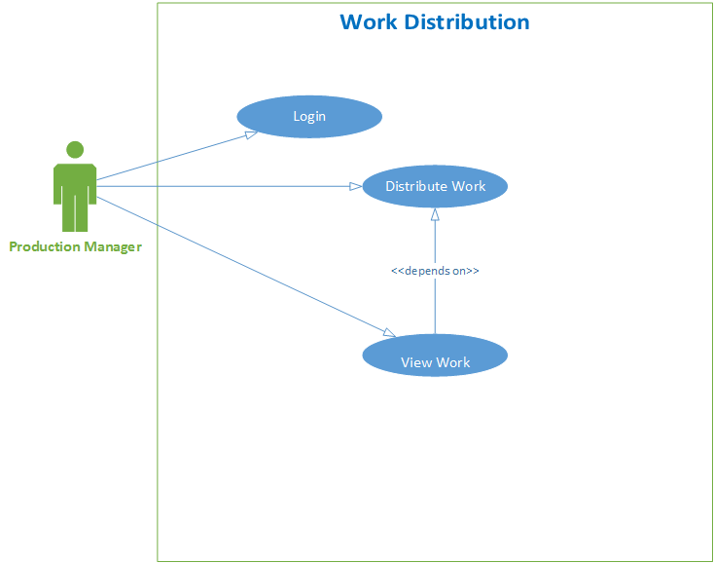

Slide 12
Use Case Narrative for Distribute Work
in Work Distribution Subsystem
Use Case Name | Distribute Work
Use Case ID | UC_WD_001
Priority | High
Primary Actor | Production Manager
Secondary Actor | <Not applicable>
Description | In this use case, all the production works related to an order will be distributed among the respective employees. He will log in into the system and select group of employees to assign them with different work types.

Slide 13
Use Case Narrative for Distribute Work
in Work Distribution Subsystem (Continued)
Pre-condition | Log in by Production Manager. An order confirmed by Client.
Trigger | This use case will be triggered when Production Manager has an order is finally confirmed.
Typical Course of events | Actor Action | System Response
 | Production Manager distributes works among employees. | System stores the distributed works.

Slide 14
Use Case Narrative for Distribute Work
in Work Distribution Subsystem (Continued)
Alternate Course of events | Actor Action | System Response
 |  | System notifies the Production Manager about unavailable employees.
Business rule | All the tasks must be distributed among group of employees.
Post Conditions | Keep track of production works.
Conclusion | This use case is concluded when all the related works are distributed among the group of employees successfully.

Slide 15
Thank you.

